Slide 1


Slide 2

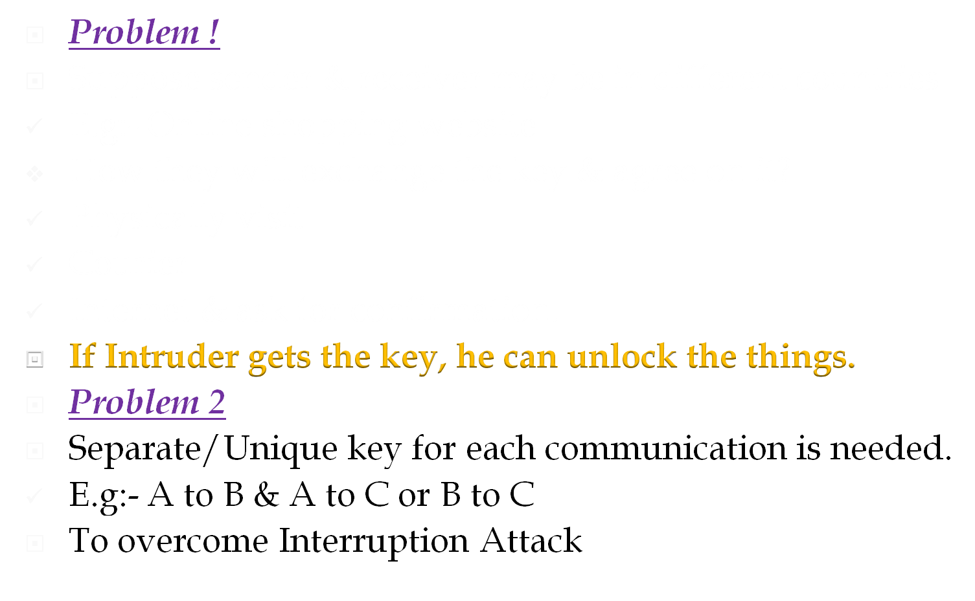
Not
Convenient

Slide 3

public-key/two-key/asymmetric cryptography involves the use of two keys:
  a public-key, which may be known by anybody can be freely distributed, and can be used to encrypt messages, and verify signatures
  a private-key, known only to the recipient, used to decrypt messages, and sign (create) signatures
is asymmetric because
  those who encrypt messages or verify signatures cannot decrypt messages or create signatures

Slide 4
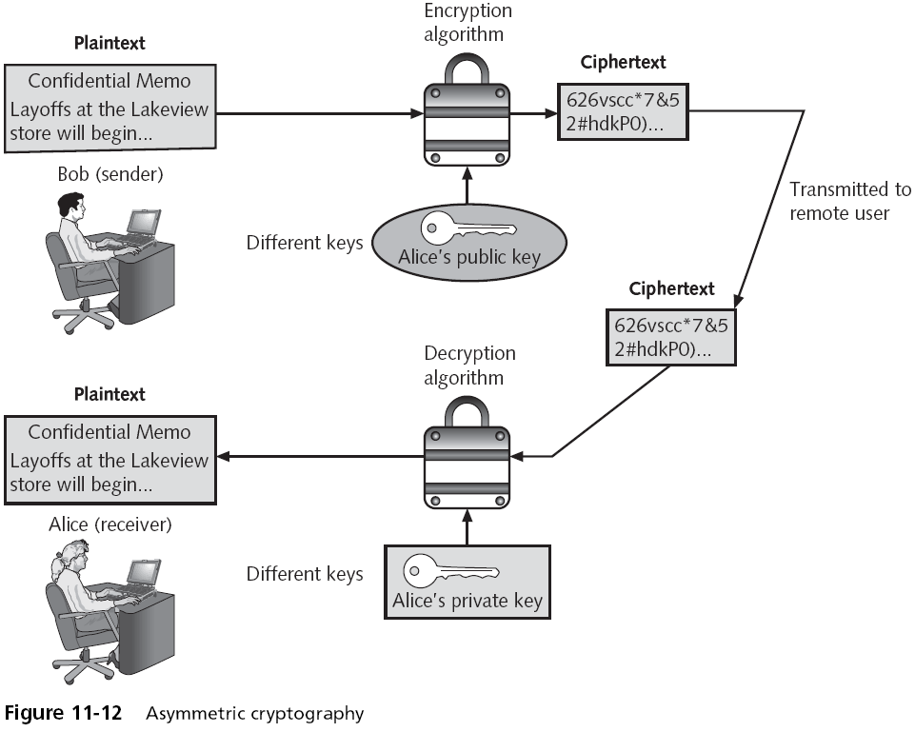

Slide 5

Introduction
Description of the algorithm
Example of the algorithm
Mathematical theory behind the algorithm
Problems with the algorithm

Slide 6

In the mid- 1970’s , Whitefield Diffie ,a student at the Stanford University met with Martin Hellman, his professor &the two began to think about it.
After some research & complicated mathematical analysis, they came up with the idea of AKC.
Many experts believe that this development is the first & perhaps the only truly revolutionary concept in the history of cryptography

Slide 7

Developed to address shortfalls of key distribution in symmetric key distribution.
A key exchange algorithm, not an encryption algorithm
Allows two users to share a secret key securely over a public network
Once the key has been shared
  Then both parties can use it to encrypt and decrypt messages using symmetric cryptography

Slide 8

Algorithm is based on “difficulty of calculating discrete logarithms in a finite field”
These keys are mathematically related to each other.
‘’Using the public key of users, the session key is generated without transmitting the private key of the users.’’
Vulnerable to “man in the middle” attacks*

Slide 9

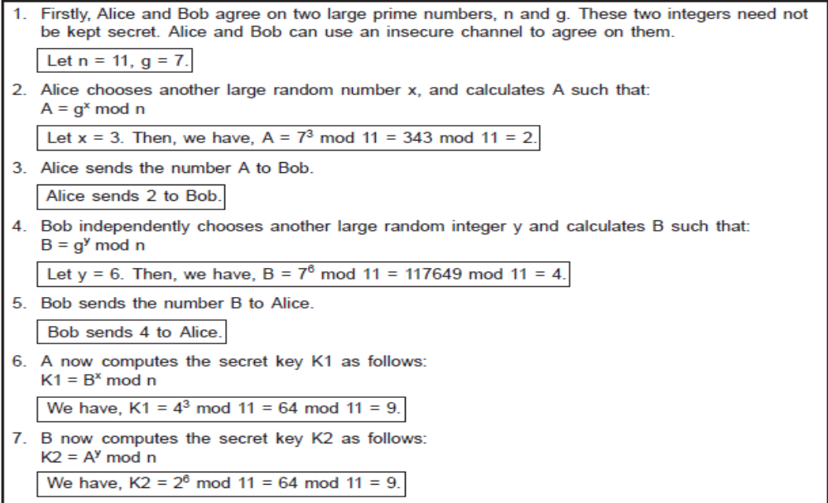

Slide 10

Public values:
  large prime p, generator g (primitive root of p)
Alice has secret value x, Bob has secret y
Discrete logarithm problem: given x, g, and n, find A
A → B: g^{x} (mod n)
B → A: g^{y} (mod n)
Bob computes (g^{x})^{y} = g^{xy}(mod n)
Alice computes (g^{y})^{x} = g^{xy} (mod n)
Symmetric key= g^{xy} (mod n)

Slide 11

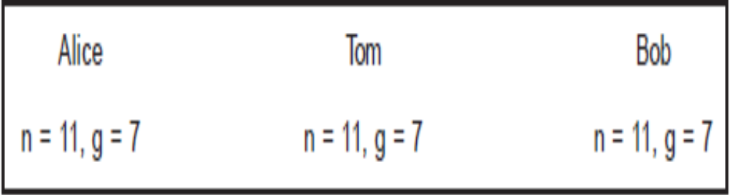
man-in-the-middle attack Part-I

Slide 12

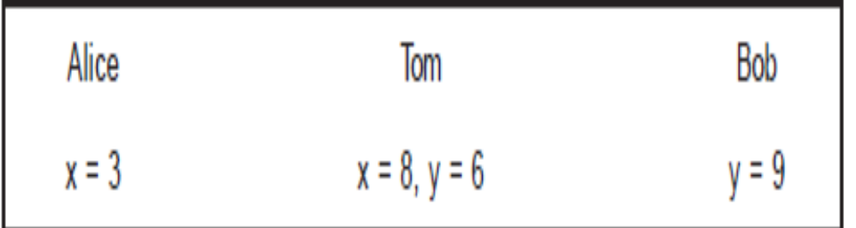
man-in-the-middle attack Part-II

Slide 13
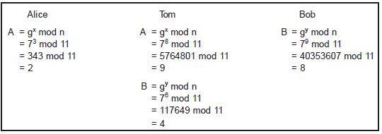
man-in-the-middle attack Part-III

Slide 14
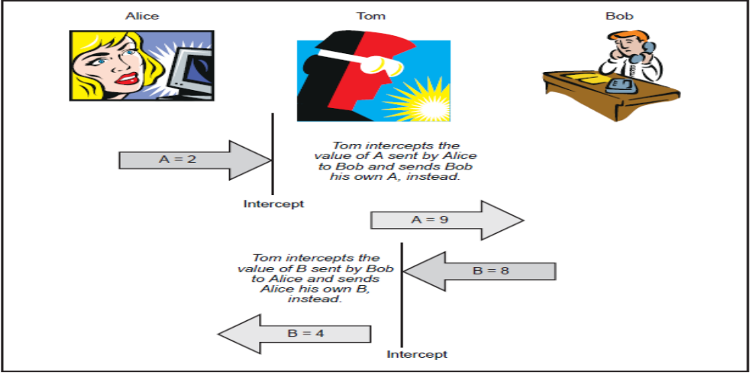
man-in-the-middle attack Part-IV

Slide 15

man-in-the-middle attack Part-V

Slide 16
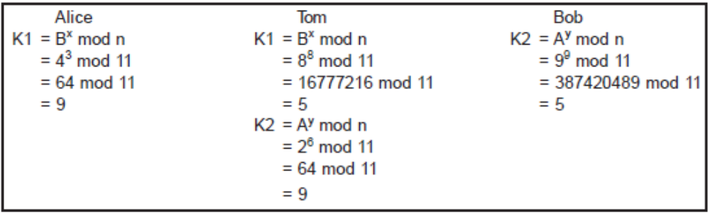
man-in-the-middle attack Part-VI

Slide 17

